Slide 1
Basics of Financial Statements
What are they and why are they important?

Slide 2
There are 3 statements used most frequently:
Balance sheet
Income statement
Cash Flow statement
Each has a different function
Together, they show the health of your business and if it is making money or not…

Slide 3
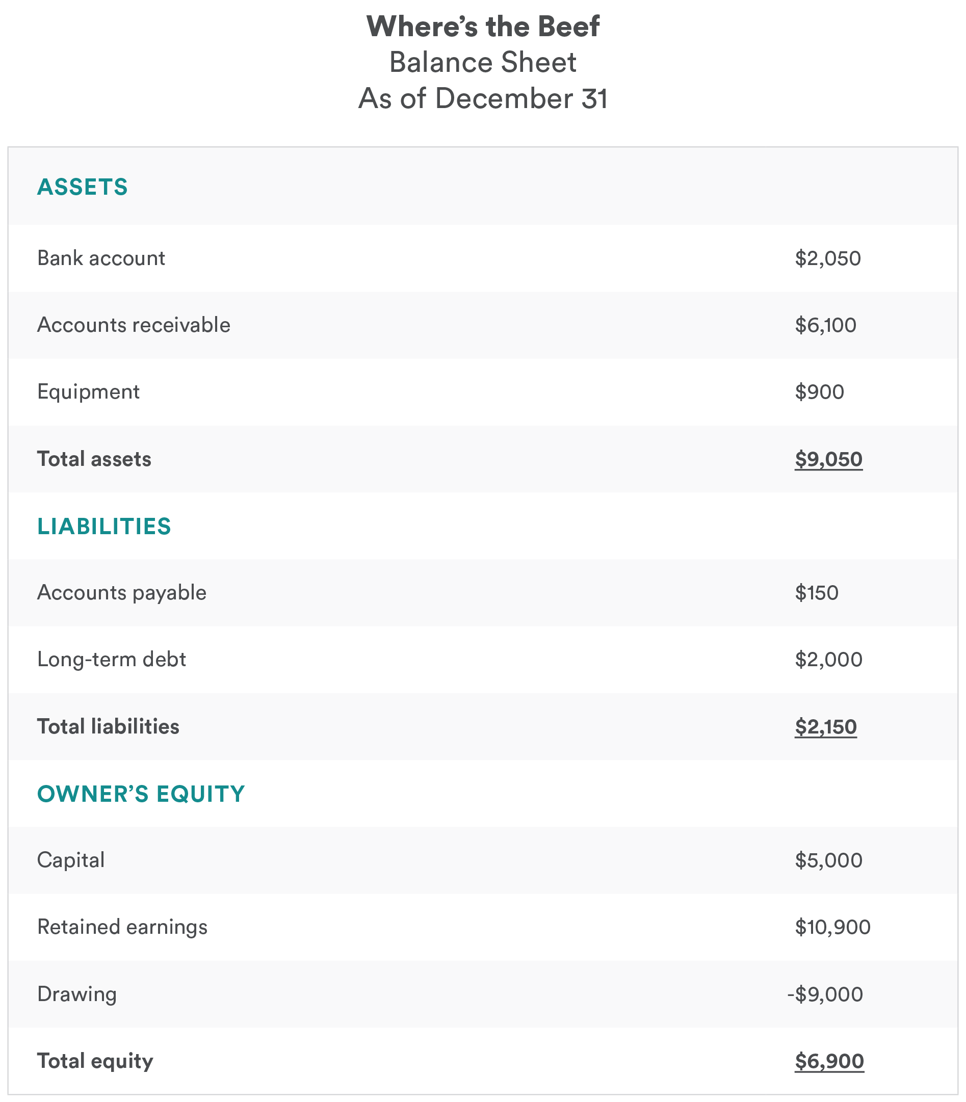
Balance Sheet
Balance sheets are organized showing 3 areas: assets, liabilities and equity.
Assets= liabilities + Equity (hence the balance)
At a glance, you can see how much money you have put in, debt you have taken on, etc.

Slide 4
Income Statement (aka profit and loss , P&L)
For Year Ended Dec. 31, 2018
Shows how much money you made and what you spent it on.
Used with the balance sheet to tie together what the earnings mean and overall health.
Category | Amount
Sales Revenue | $57,050.68
Cost of Goods Sold (COGS) | $24,984.79
Gross Profit | $32,101.89
General Expenses | $11,049.55
*Rent | $9,000.00
*Bank & ATM Fee Expenses | $9.43
*Equipment Expenses | $742.40
*Marketing Expenses | $503.53
*Merchant Fees Expenses | $794.19
Operating Earnings | $21,052.34
Interest Expense | $5,000.00
Earnings Before Income Tax | $16,052.34
Income Tax Expense | $10,000.00
Net Profit | $6,052.34

Slide 5
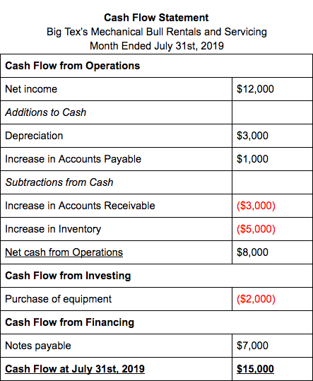
Cash Flow Statement
Shows the flow of money coming and going
Shows what you actually have

Slide 6
Additional Helpful Info:
SAVE BUSINESS RECEIPTS!
Keep business and personal purchases separate.
Anything purchased for the business is deductible.
Make sure to note if combined purchases which are business. (see schedule C for categories or all spreadsheets have most common categories)
COG/COGS- “Cost of Goods/ Sold”
If your business is a product, or service with a product, you have a COG.
Examples of COG: parts, construction materials, any product for resale, anything that goes into a finished product (ie. Jars, lids, ingredients, labels, packaging, etc.)

Slide 7
For those of you who have been doing your bookkeeping manually (like in a notebook) or going by what “square” tells you…you are halfway there!
Questions? Concerns?

Slide 8
Contact Info for consultations:
Trish Abbin
fatcatenterpriseslc@gmail.com
505-280-6502
Tessah Latson
Tessah.latson@gmail.com
505-401-3242

