Slide 1
Transitioning to online: Staying resilient during covid 19
Alison Turner
Technical assistance Specialist
NCNMEdD

Slide 2
Starting from zero
Contactless payment options
Building an online presence from scratch

Slide 3
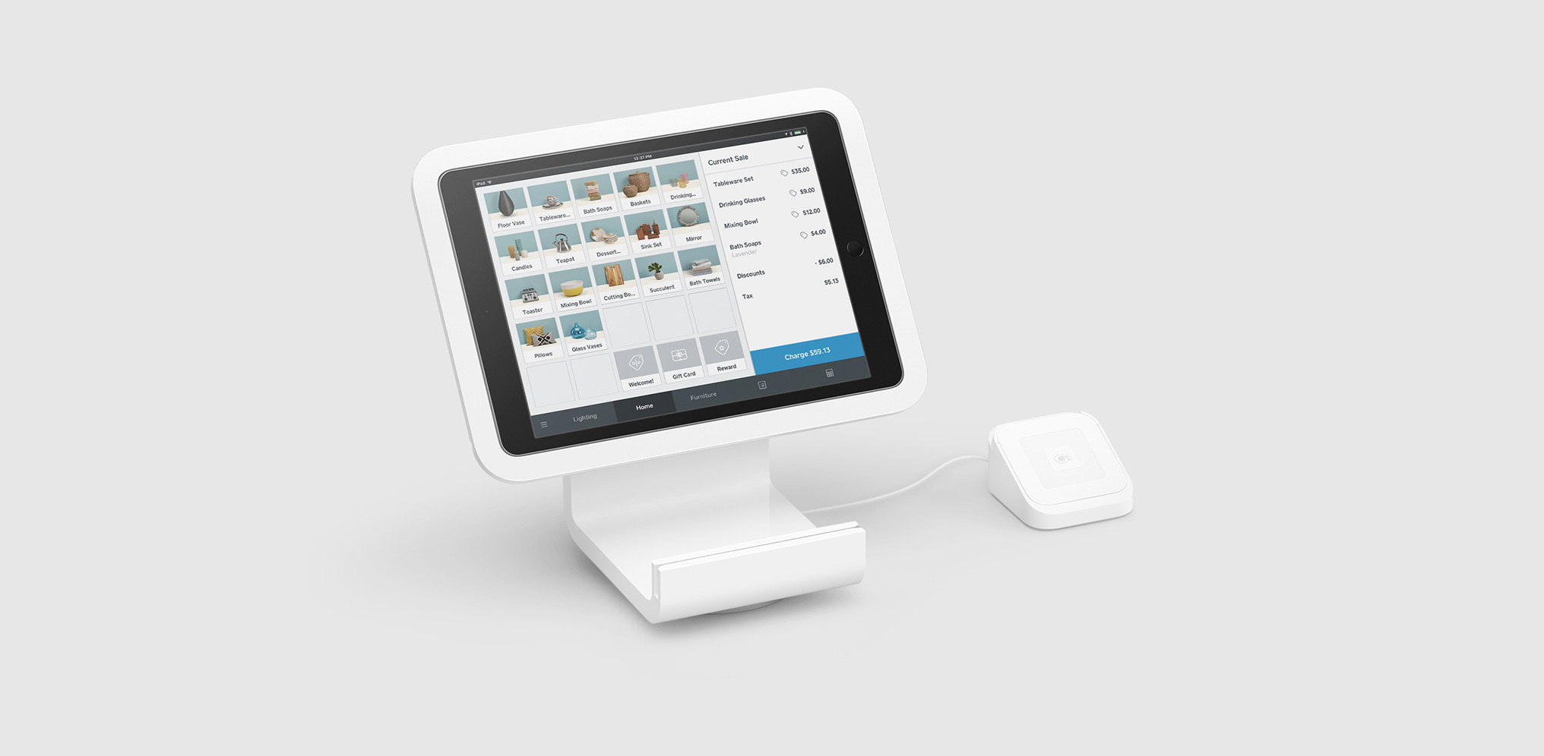
Contactless payment
Where do I get it?
Direct sale (Square, Shopify, Clover)
Retailers (Sam’s Club, Costco, Amazon)
How do I set it up?
How do I let customers know I’m ready for them?
Onsite marketing
Community resources (Taos MainStreet)
Online marketing
Notes:
https://www.merchantmaverick.com/the-best-credit-card-reader-for-your-small-business/

Slide 4
Connecting to an online audience
Online Marketplaces
Facebook Marketplace
Craigslist
Retail spaces
Instagram Shopping
Etsy
Amazon
Notes:
https://craigslist.org/
https://business.instagram.com/getting-started/?ref=sem_smb&cid=8279733501&agid=85640798592&kw=instagram%20shopping&nk=g&utm_source=GOOGLE&utm_medium=fbsmbsem&utm_campaign=G_S_Alpha_Instagram_Brand_US_EN_Tenured_General&utm_keyword=instagram%20shopping&kenid=_kenshoo_clickid_&utm_content=instagram%20shopping&gclid=EAIaIQobChMIoIO4taLf6gIViIbACh15wQVWEAAYAyAAEgK75PD_BwE
https://www.etsy.com/sell

Slide 5
Website enablement
What’s the first step?
Editor driven (Wix, Weebly, Wordpress)
Reader driven
How do I purchase a domain (and what is that)?
GoogleDomains
GoDaddy, domain.com
Editor Provided
How do I enable a website shopping experience?
Cataloging and shopping

Slide 6
So I’m online, now what?
Tracking visitors
Keeping your website up to date

Slide 7
Tracking your traffic
Why does it matter?
Knowledge is power
Google Page Ranking
What can I use?
Your site editor
Google Analytics

Slide 8
Keeping up to date
Catalog up to date
Contact information
Syncing with GoogleMaps and other points of contact

Slide 9
Where do we go from here?
Reaching the unreachable customer
Connecting and keeping creative

Slide 10
Reaching the unreachable
Marketing, advertising, data sharing, social media
Online forums
Handwritten letters
Connections around the community

Slide 11
Questions to keep in mind
What’s worked for my business? What do I need help with?
What’s the craziest idea I’ve heard out of this pandemic so far? How can I take it further?
Who is someone that is outside my industry that might have insight to big recovery ideas?

Slide 12
Thank you
alisont@ncnmedd.com | 505 – 716 - 5580

